Slide 1


CRIMEGUARD
DEPARTMENT OF COMPUTER SCIENCE 4th YEAR
ASHOKA INSTITUTE OF TECHNOLOGY AND MANAGEMENT
SESSION- 2023-2024
GROUP LEADER : RITU PARNA BANERJEE
GROUP MEMBERS : AINDREE ANIL
AMAN CHAURASIA
MOHIT KUMAR SINGH
TASNEEM FATIMA ZAIDI
SUPERVISOR: Mrs. SONI OJHA
ASSISTANT PROFESSOR
(C.S.E DEPARTMENT )

Slide 2


PROBLEM STATEMENT
Traditional crime prevention methods struggle in the digital realm, resulting in imprecise identification of criminals and understanding online criminal activities.
This leads to false positives, misidentifications, and challenges in evaluating social media content, hindering law enforcement efforts.
02

Slide 3


OBJECTIVES
Enhance Criminal Identification Accuracy
Social Media Analysis
03
SOURCE :www.freepik.com

Slide 4
INTRODUCTION
Multifaceted Approach: Integrates social media analysis, data management, retina tracking, and advanced facial recognition for precise identification.
Sentiment Analysis and NLP: Utilizes sentiment analysis and NLP to decode emotions from text and images from social media, providing insights into online criminal activities.
04

Slide 5

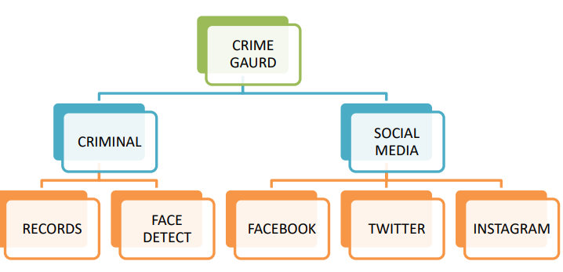
05

Slide 6
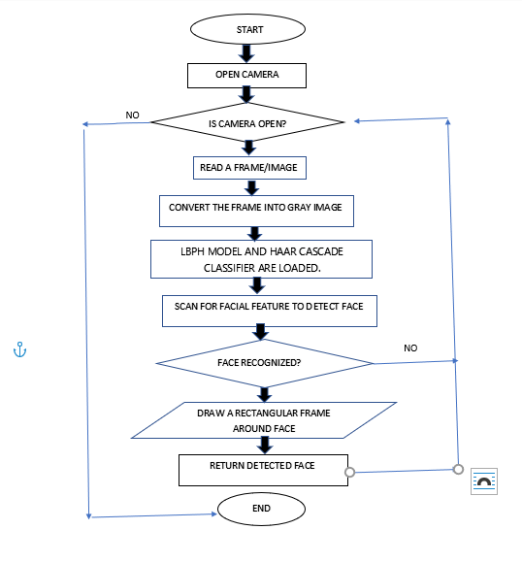
METHODOLOGY
FIG. 02 : FLOWCHART OF CRIMINAL FACE RECOGNITION
06

Slide 7
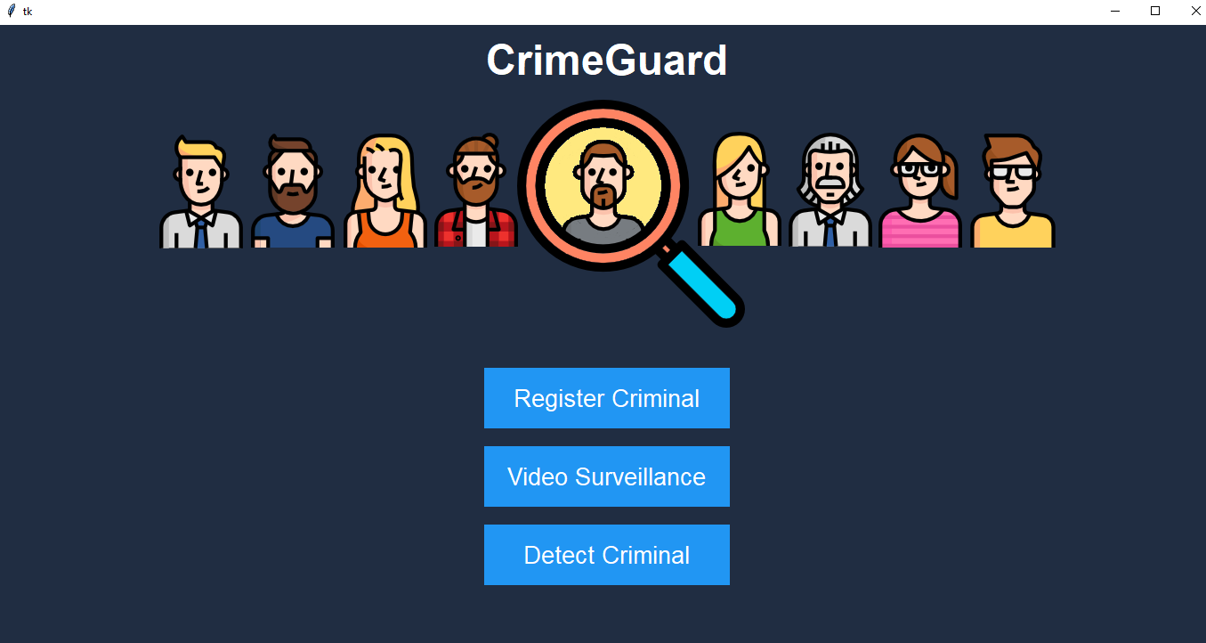
OUR PROJECT
FIG. 03: FRONT PAGE OF CRIME GUARD PROJECT
07

Slide 8
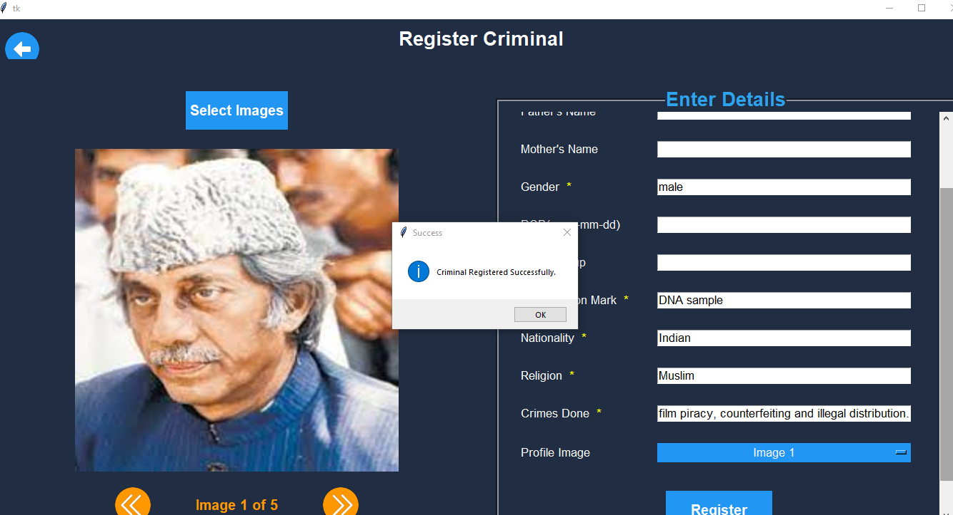
FIG. 04: REGISTERING THE CRIMINALS
08

Slide 9
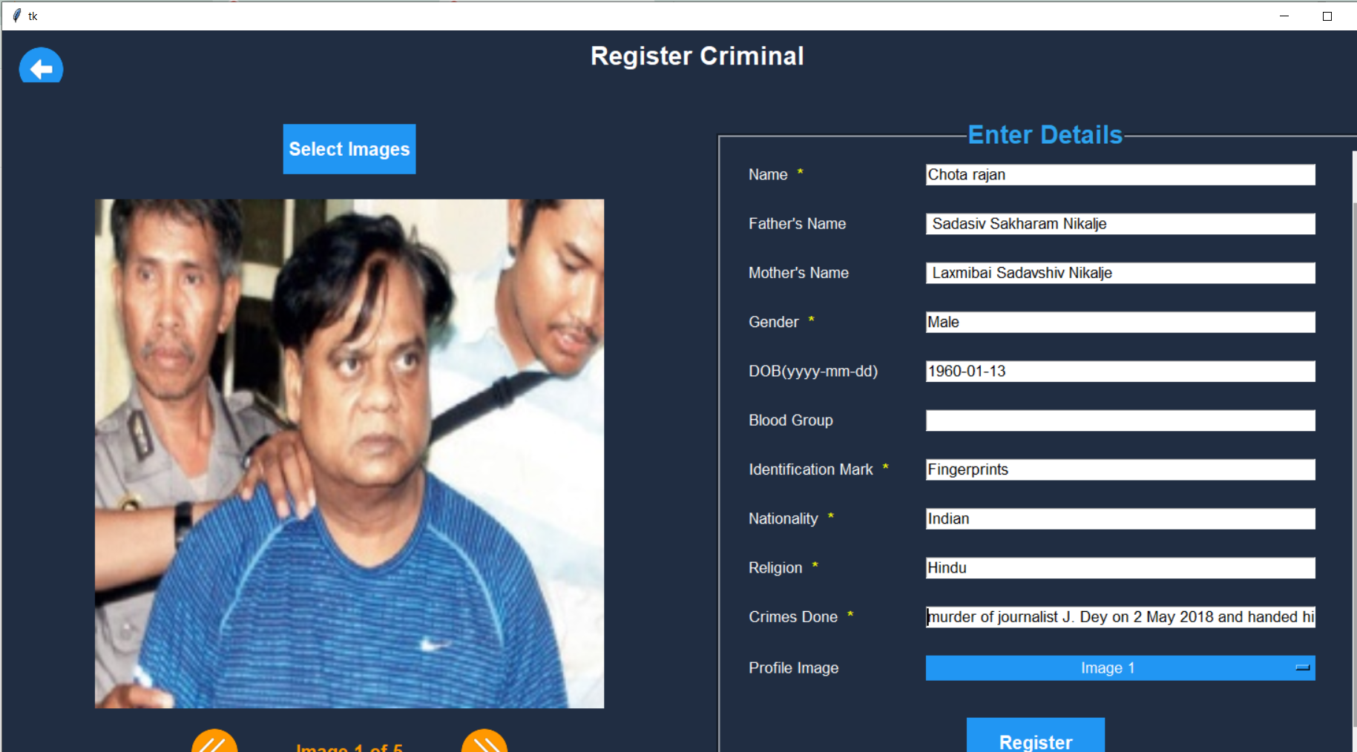
FIG. 05: REGISTERING THE CRIMINALS
09

Slide 10
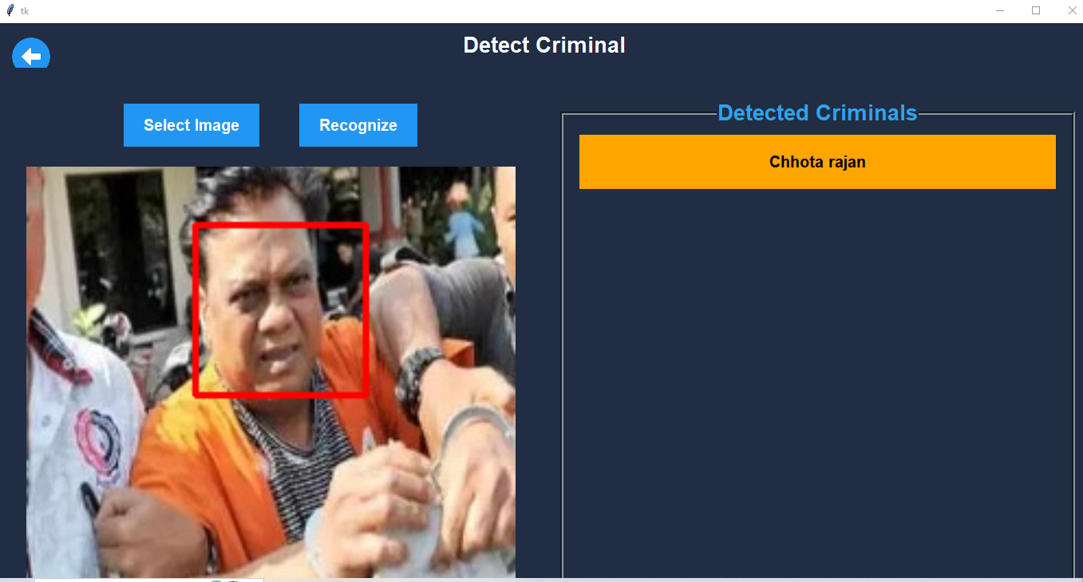
FIG. 06: DETECTING THE CRIMINALS
10

Slide 11
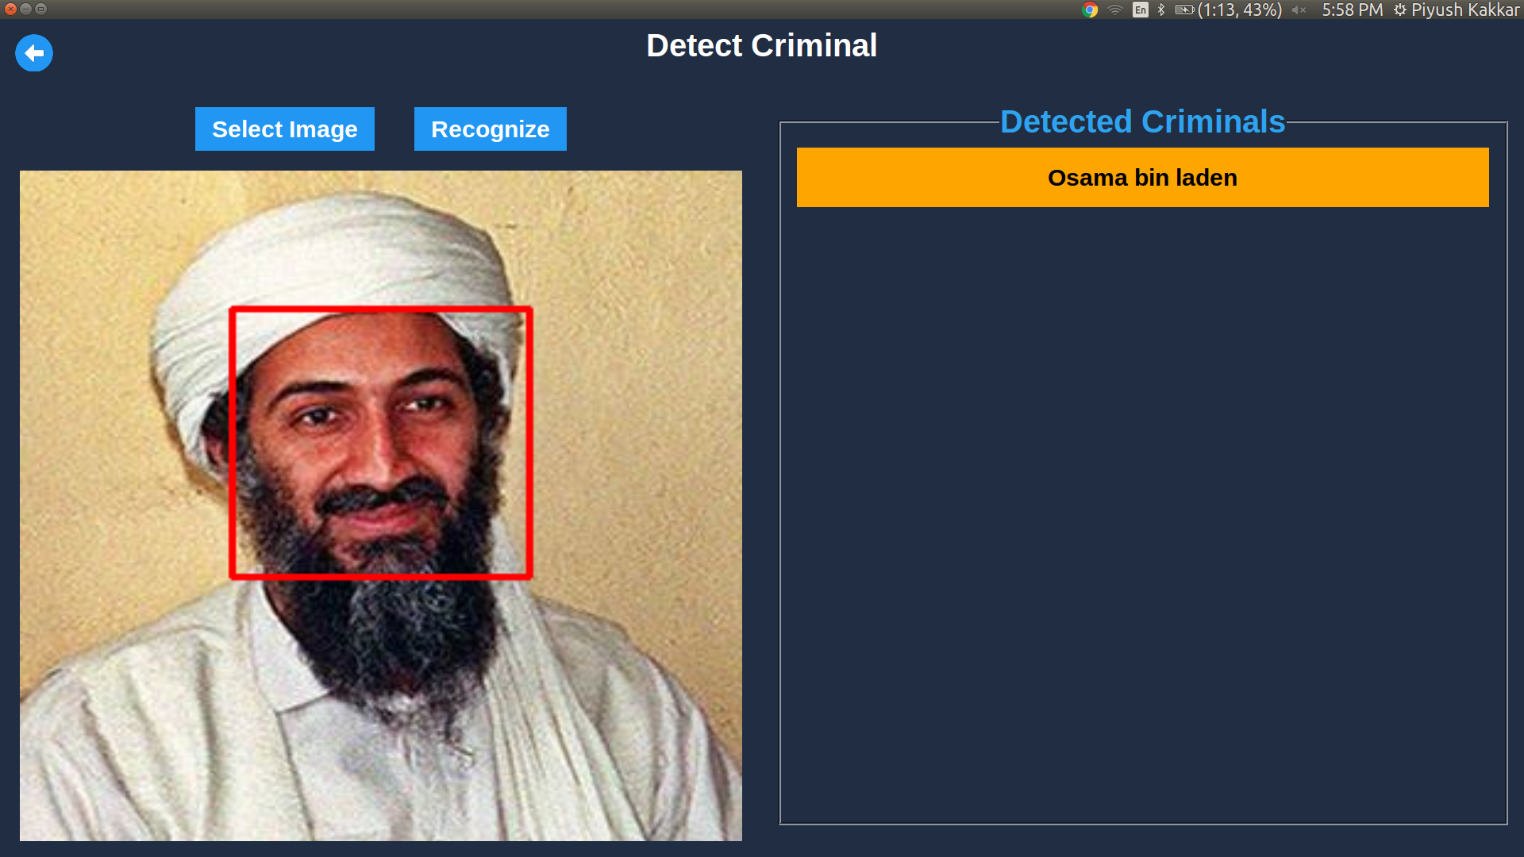
FIG. 07: DETECTING THE CRIMINALS
11

Slide 12
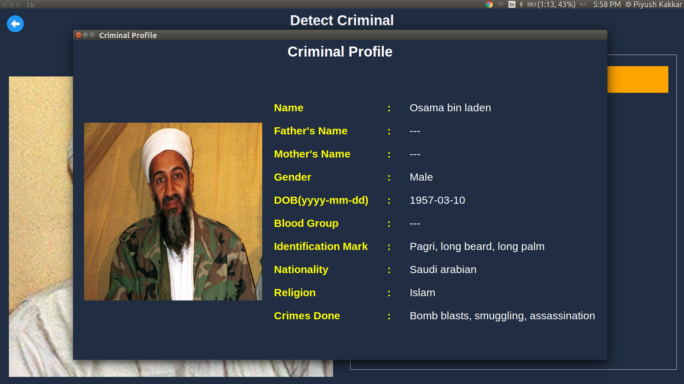
12
FIG. 08: CRIMINAL MATCHED WITH EXISTING DATABASE

Slide 13
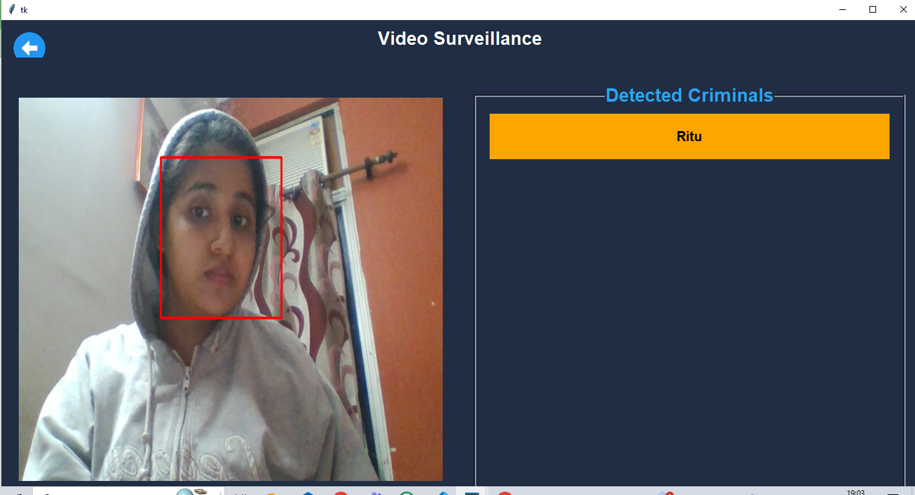
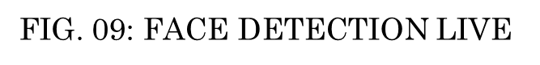
13

Slide 14
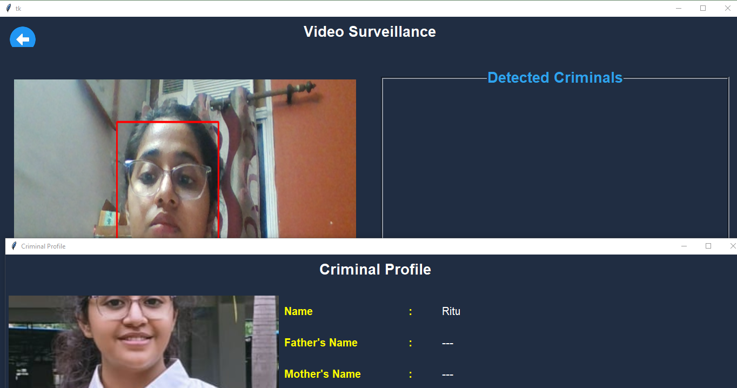
FIG. 10: FACE DETECTION LIVE
14

Slide 15
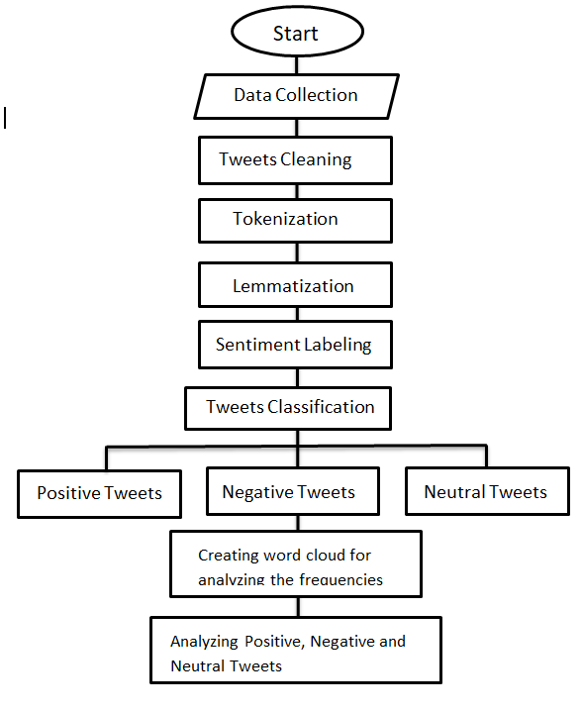
METHODOLOGY
FIG. 11: FLOWCHART OF CRIMINAL SENTIMENT ANALYSIS FROM TWITTER BY USING LSTM ALGORITHM
15

Slide 16
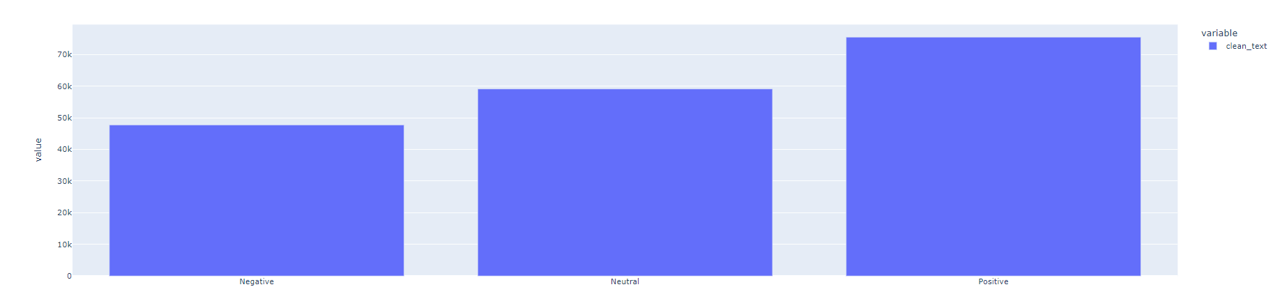
OUR PROJECT
FIG. 12: THE DISTRIBUTION OF SENTIMENTS
16

Slide 17
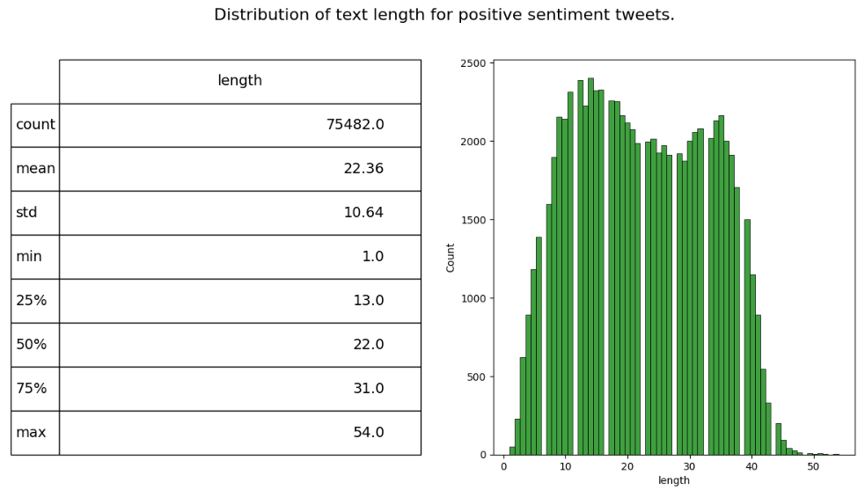
FIG. 13: THE DISTRIBUTION OF POSITIVE SENTIMENTS
17

Slide 18
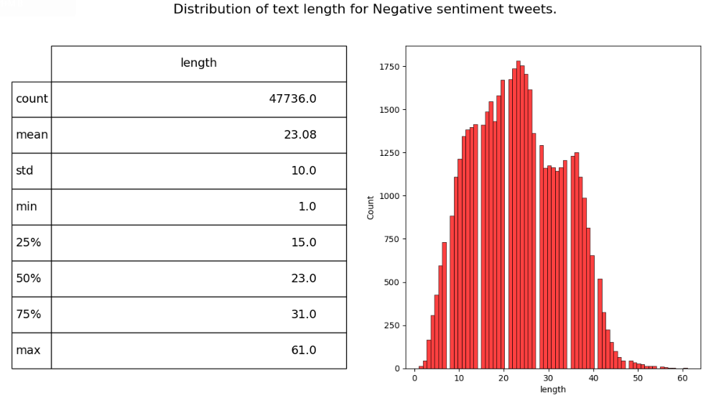
FIG. 14: THE DISTRIBUTION OF NEGATIVE SENTIMENTS
18

Slide 19
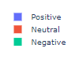
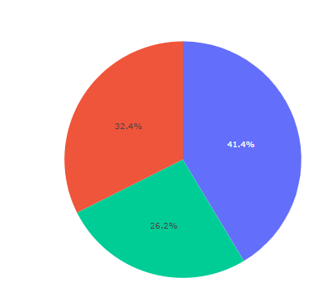
FIG. 15: PIE CHART OF DIFFERENT SENTIMENTS OF TWEETS
19

Slide 20
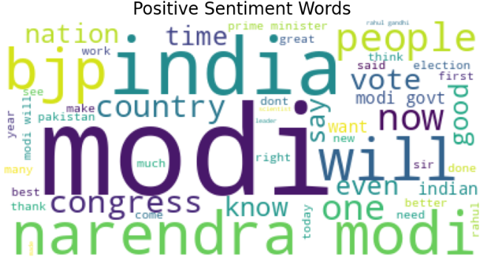
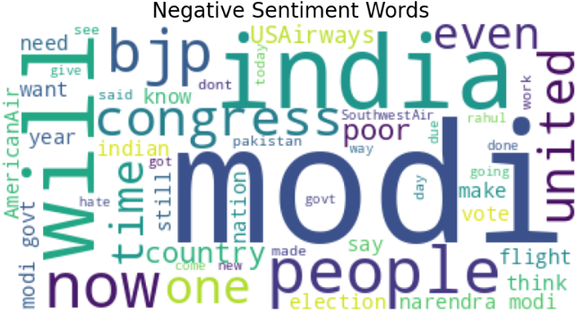
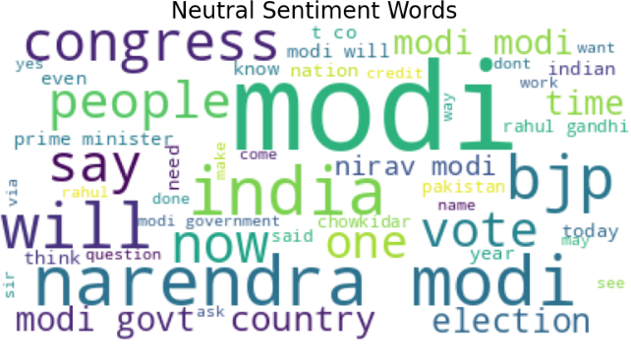
20
FIG. 16: DIFFERENT SENTIMENTS WORDS FROM TWEETS

Slide 21
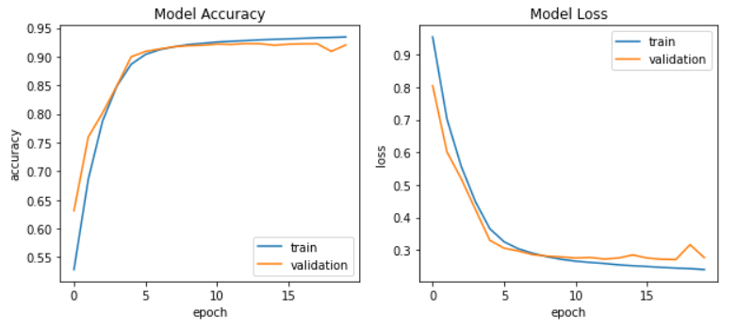
FIG. 17: MODEL ACCURACY AND LOSS
21

Slide 22
HARDWARE AND SOFTWARE REQUIREMENTS
HARDWARE REQUIRED :-
Ram: minimum 8 GB
Processor: intel core i3
Mouse: scroll or optical mouse
Keyboard: Standard 110 key keyboard
SOFTWARE REQUIRED :-
Operating System: Windows
SDK: Python, Required Libraries
Database used MySQL
22

Slide 23
FUTURE SCOPE
Advanced Technologies Integration:
Explore integrating block chain for enhanced security and consider adopting more advanced deep learning models to further improve accuracy.
Expanded Data Sources:
Broaden data sources beyond social media to include public records and digital footprints for a more comprehensive approach to criminal identification.
23

Slide 24
CONCLUSION
Crime Guard, with its advanced technology and comprehensive approach, is poised to revolutionize criminal identification.
The project's continuous evolution and integration of cutting-edge technologies ensure a lasting impact on law enforcement and public safety.
24

Slide 25
THANK YOU
25

